Slide 1
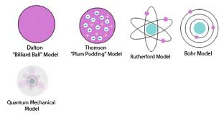
ATOMIC STRUCTURES
History of The Atom Models
Democritus 460 BC and Dalton 1803 AD
Thomson 1897
Rutherford 1912
Bohr1913
1900s Max Planck, Albert Einstein, Niels Bohr, Louis de Broglie, Max Born, Paul Dirac, Werner Heisenberg, Wolfgang Pauli, Erwin Schrödinger, Richard Feynman

Slide 2
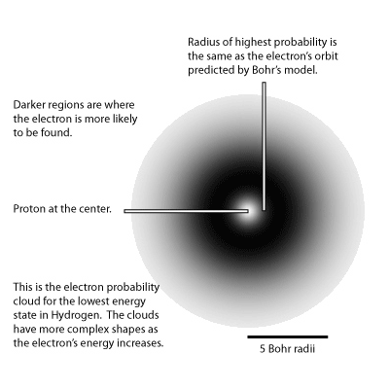
Modern Atomic Model (quantum atomic model)
• The atom as mostly empty space with a tiny massive nucleus with protons and neutrons at the center.
Electrons moving too fast to describe their location in space and time and surround the nucleus in a cloudlike region.

Slide 3
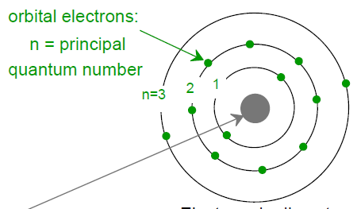
Electrons in Atoms
Classical mechanics does not completely explain many phenomena involving electrons in solids.
Quantum mechanics (a set of principles and laws that govern systems of atomic and subatomic entities) is needed to understand the behavior of electrons in atoms and crystalline solids.
Schematic representation of the Bohr atom
Electrons in discrete orbitals.
Mass of protons and neutrons:
1.67 × 10⁻²⁷ kg
Mass of electrons:
9.11 × 10⁻³¹ kg
Electric charge of electrons and protons
1.6 × 10⁻¹⁹ Coulomb
Nucleus
Z = # protons
N = # neutrons
Bohr model
e⁻s are assumed to revolve around the atomic nucleus in discrete orbitals,
to describe electrons in atoms, in terms of both position (electron orbitals) and energy (quantized energy levels).
Z is also atomic number.
Atomic mass A ≈ Z + N

Slide 4
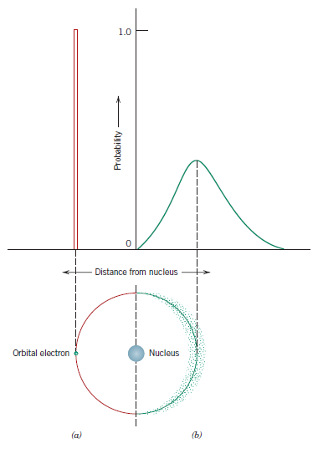
2nd week: Atomic Structure
Electrons in Atoms
Comparison of Bohr and Quantum Mechanics (QM) models
Quantum Mechanics:
e⁻s exhibit both wavelike and particle-like characteristics.
With this model, an electron is no longer treated as a particle moving in a discrete orbital (Bohr); rather, position is considered to be the probability of an electron’s being at various locations around the nucleus.
In other words, position is described by a probability distribution or electron cloud.
(a) Bohr and (b) wave mechanical
atom models of hydrogen atom in terms of electron distribution.

Slide 5
Electrons in Atoms
Quantum Numbers
Quantum numbers designate specific levels, subshells, orbitals, and spins of electrons. This means that they are describing in detail the characteristics of the electrons in the atoms.
the principal quantum number (n) : referring to the size of the orbital and the energy level an electron is placed in (shells). Sometimes these shells are designated by the letters K, L, M, N, O, and so on, which correspond, respectively, to n 1, 2, 3, 4, 5, . . . ,
2.the orbital angular momentum quantum number (l): signifies the subshell, which is denoted by a lowercase letter—an s, p, d, or f. describes the shape of the orbital. You can also use l to find the number of angular nodes.
3. the magnetic quantum number (ml): The number of energy states for each subshell. For an s subshell, there is a single energy state, whereas for p, d, and f subshells, three, five, and seven states exist, respectively.
4.the electron spin quantum number (ms): referring to the spin on the electron, which can either be up or down.
m_{s}= +1/2 or -1/2
l=0, 1, 2, 3, 4…, (n-1)
m_{l}= -l, (-l +1),( -l +2),…, -2, -1, 0, 1, 2, … (l – 1), (l – 2), +l

Slide 6
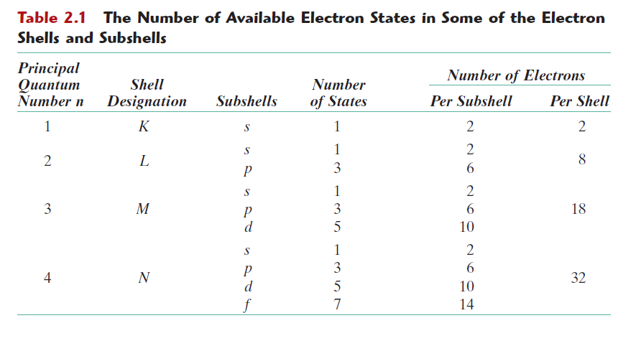
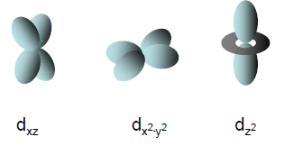

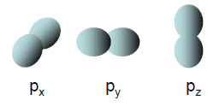
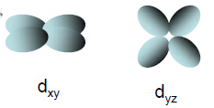
Electrons in Atoms
Atomic orbitals

Slide 7
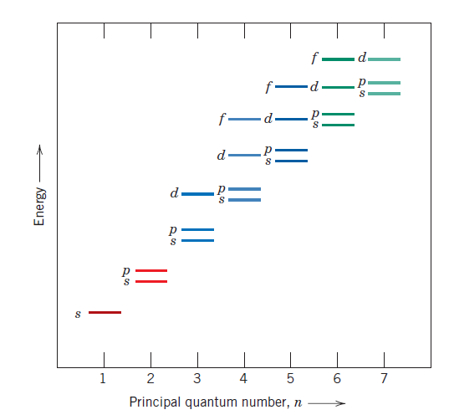
Electrons in Atoms
Schematic representation of the relative energies of the electrons for the various shells and subshells.
the smaller the principal quantum number, the lower the energy level
within each shell, the energy of a subshell level increases with the value of the l quantum number
there may be overlap in energy of a state in one shell with states in an adjacent shell

Slide 8
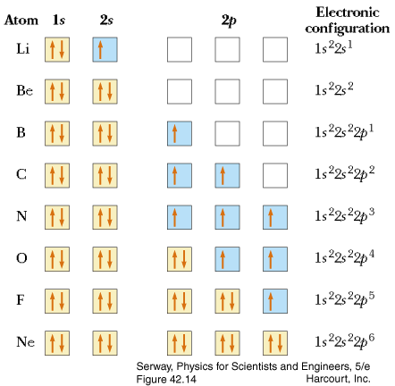
Electrons in Atoms
Pauli Exclusion Principle
In 1926, Wolfgang Pauli discovered that a set of quantum numbers is specific to a certain electron.
Two electrons in an atom can never have exactly the same set of all 4 quantum numbers (n, l, m_{l}, m_{S})
«Although the first three quantum numbers identify a specific orbital and may have the same values, the fourth (ms) is significant and must have opposite spins»
ms= +1/2 or -1/2

Slide 9
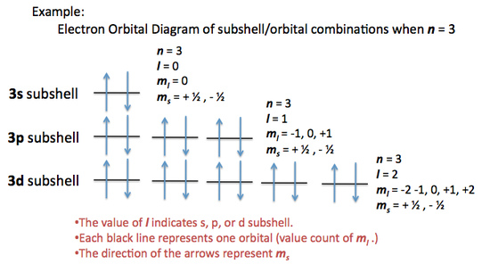
Electrons in Atoms

Slide 10
Electrons in Atoms
Valence electrons
The electrons in the outer shell (largest n) are called valence electron
Very important for chemical reactions and holding matter together
Many of the physical and chemical properties of solids are based on these valence electrons.
Mg: 1s²2s²2p⁶ 3s² valence = 2
Al: 1s²2s²2p⁶ 3s²3p¹ valence = 3
If the outer shell is filled, the atom is inert. If not, there is a tendency for the outer shell to become filled.
Argon
1s²2s²2p⁶ 3s²3p⁶

Slide 11
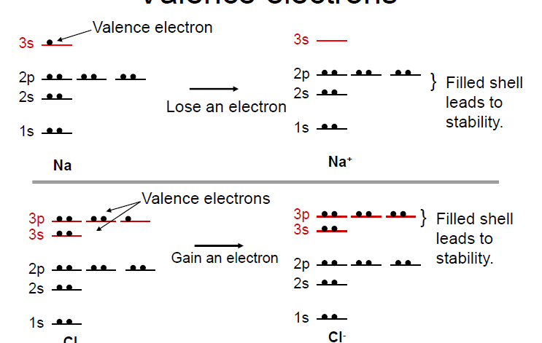
Electrons in Atoms
Valence electrons

Slide 12
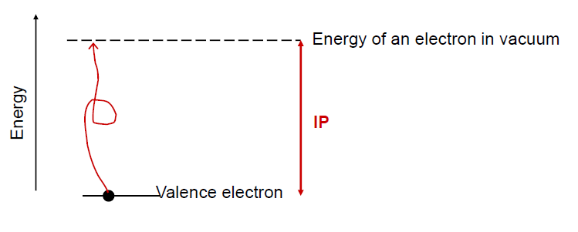
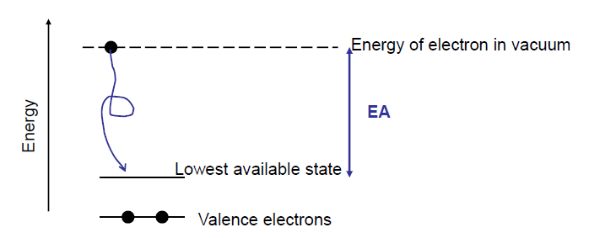
Energy to take an electron out of an atom
Ionization potential (IP): Energy required to pull out a valence electron (in vacuum).
By convention, IP is positive (i.e. need to put in energy to pull out the electron).
Energy to place an electron in an atom
Electron Affinity (EA): Energy gained by putting an electron in (from
vacuum).
By convention, EA is negative (i.e. electron goes from higher energy state in vacuum to lower energy state in atom).

Slide 13
PERIODIC TABLE

Slide 14
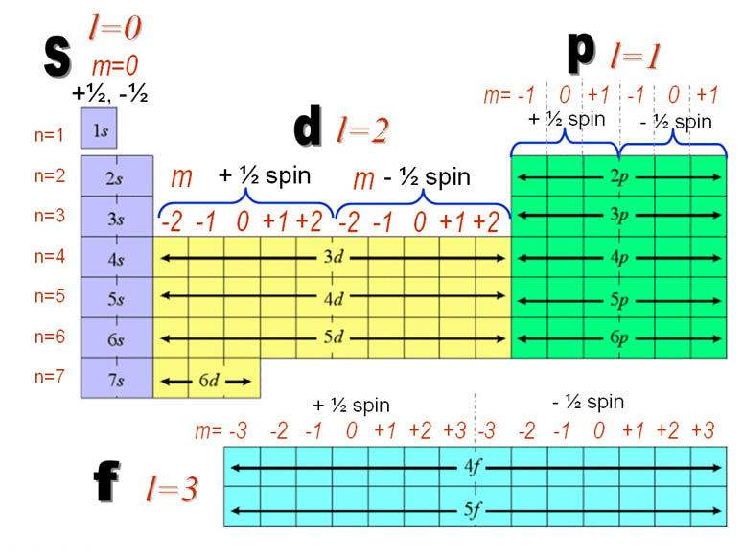
Periodic Table
Period 1
Period 2
Period 3
Period 4
Period 5
Period 6
Period 7
Notes:
All the elements have been classified according to electron configuration so their Quantum numbers
in the periodic table

Slide 15
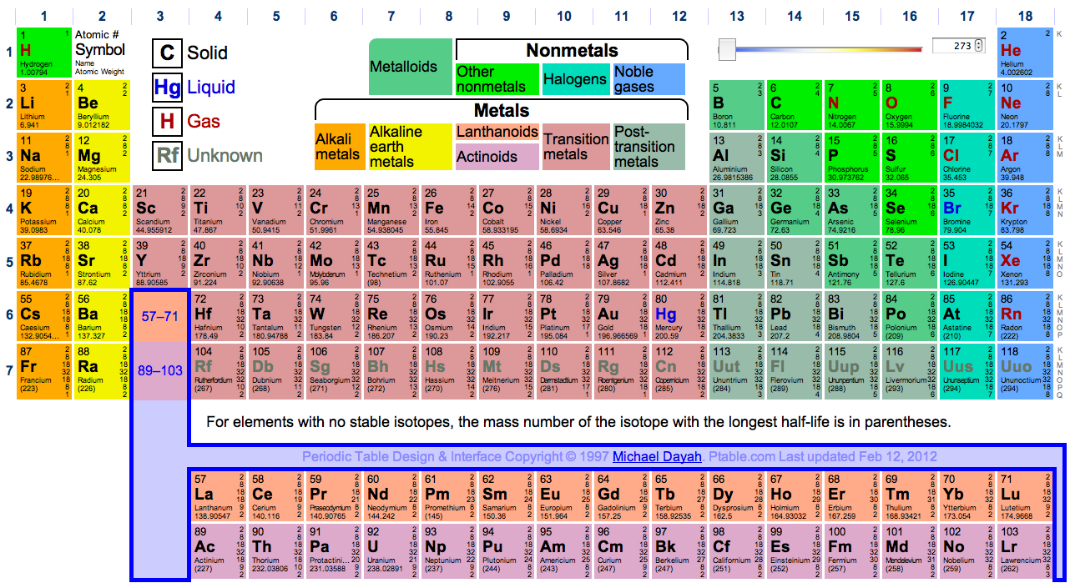
Periodic Table
© 2003 Brooks/Cole Publishing / Thomson Learning™

Slide 16
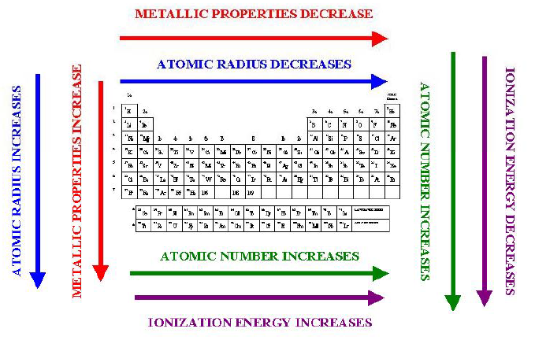
SUMMARY OF TRENDS IN THE PERIODIC TABLE
ionization energy=electronegativity

Slide 17
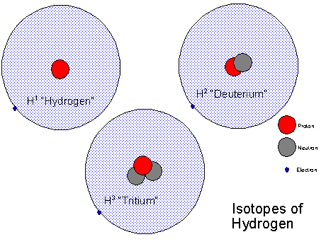
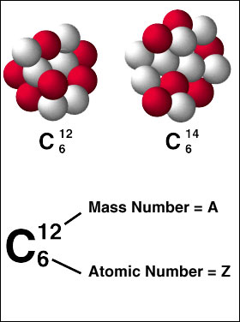
Atomic Structure
FUNDAMENTAL CONCEPTS
Atoms of the same element can have different numbers of neutrons; the different possible versions of each element are called isotopes.
http://www.atomicarchive.com/Physics/Physics3.shtml
Notes:
For example, the most common isotope of hydrogen has no neutrons at all; there's also a hydrogen isotope called deuterium, with one neutron, and another, tritium, with two neutrons.

Slide 18
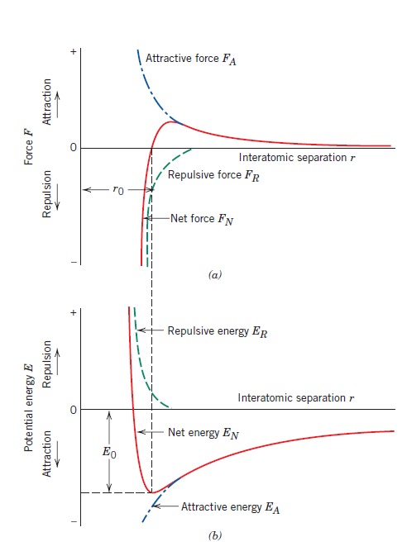
Bonding forces and energies
Builts attractive forces
Schematic plot of attractive force (F_{A}) and repulsive force (F_{R}) versus r.
F_{N} = F_{A}+ F_{R}
F_{N} = net force between the two atoms
Builts repulsive forces
Attractive force (F_{A}) depends on the type of bonding existing between the two atoms
Repulsive force (F_{R}) arise from interactions between the negatively charged electron clouds for the two atoms
At the state of equilibrium
F_{A}+ F_{R} = O
The centers of the two atoms will remain separated by the equilibrium spacing r₀ (≈0.3nm)

Slide 19
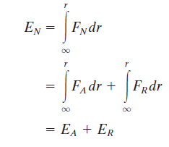
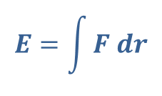
Bonding forces and energies
The dependence of repulsive, attractive, and net potential energies on interatomic separation for two isolated atoms.
$$E=\int{F dr}$$
for atomic systems,
The minimum in the net energy curve @ r₀ => bonding energy for these two atoms, E₀, corresponds to the energy at this minimum point.
E_{N} = E_{A}+ E_{R}
E_{N} = net energy
E_{A} = attractive energy
E_{R} = repulsive energy

Slide 20
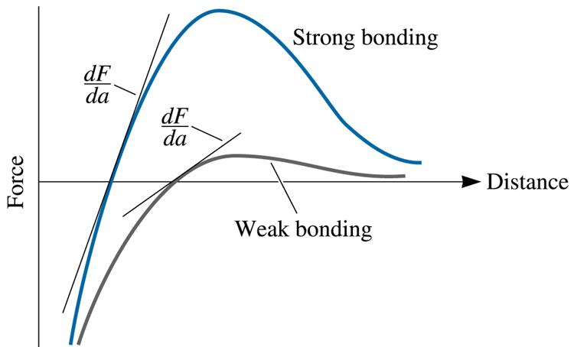
Bonding forces and energies
The magnitude of the bonding energy and the shape of the energy–versus– interatomic separation curve vary from material to material, and they both depend on the type of atomic bonding.
Material properties depend on E₀, the curve shape, and bonding type.
Large bonding energy
Low thermal expansion coefficient
Small dimensional alterations
in temperature changes
The force-distance curve for two materials, showing the relationship between atomic bonding and the modulus of elasticity, a steep dF / da slope gives a high modulus
© 2003 Brooks/Cole Publishing / Thomson Learning™

Slide 21
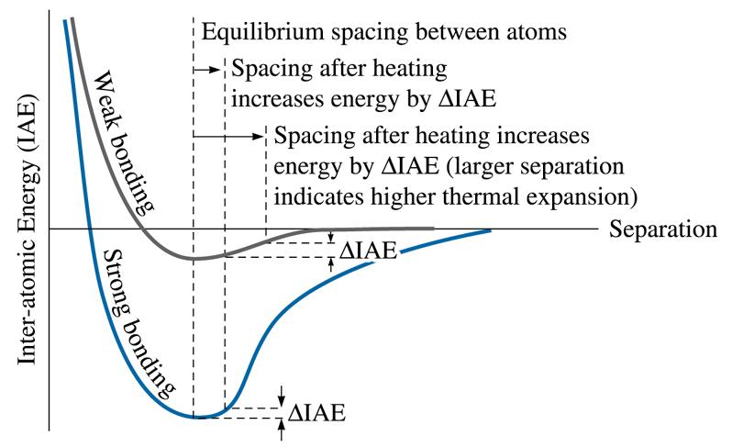
Bonding forces and energies
© 2003 Brooks/Cole Publishing / Thomson Learning™
The inter-atomic energy (IAE)-separation curve for two atoms.
Materials that display a steep curve with a deep trough have low linear coefficients of thermal expansion.

Slide 22
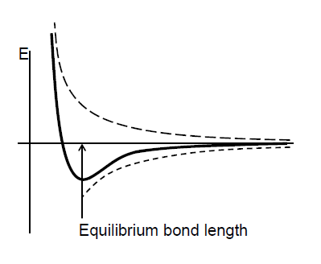
Atomic Bonding
Primary
Ionic
Covalent
Metallic
Secondary
Dipole-dipole
H bonds
Dipole-induced-dipole
Fluctuating dipoles

Slide 23
Atomic Bonding
Primary or chemical bond are found in solids
Ionic
Covalent
Metallic
Secondary or physical forces
Dipole-dipole
H bonds
Dipole-induced-dipole
Fluctuating dipoles
İnvolving valence e⁻s
the nature of the bond depends on the e⁻ structures of the constituent atoms
Arising from the tendency of the atoms to assume stable e⁻ structures, to fill the outermost e⁻ shell, like the inert gases
found in many solids
weaker than the primary ones
influence the physical
properties of some materials.

Slide 24
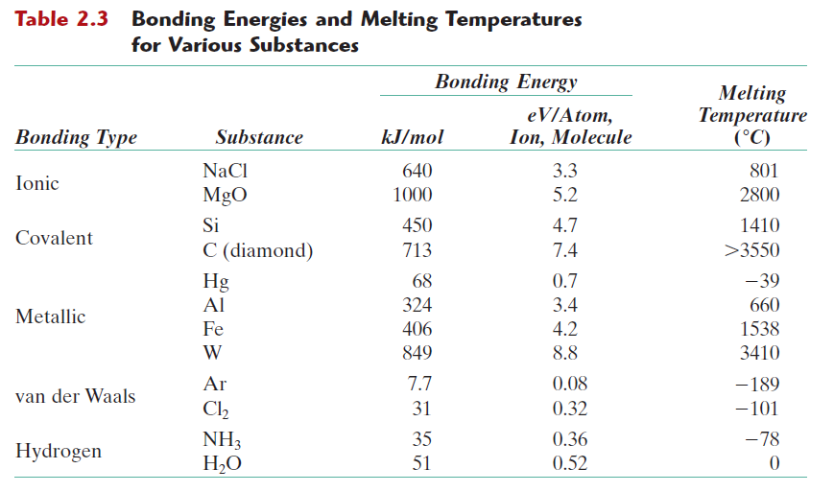

Slide 25
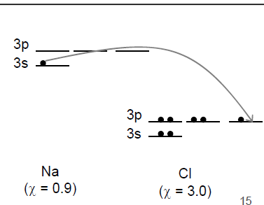
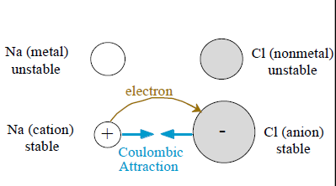
Primary interatomic bonds
Ionic Bonding
Requires electron transfer
Composing of both metallic and nonmetallic elements (Occurs between + and – ions)
Atoms of a metallic element easily give up their valence electrons to the nonmetallic atoms.
Large difference in electronegativity required.

Slide 26
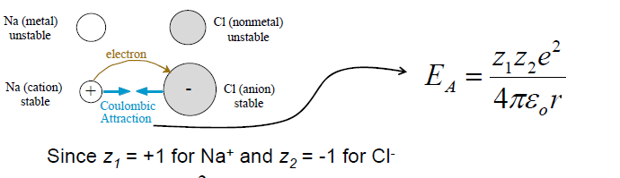
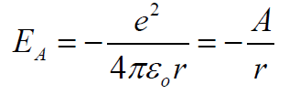
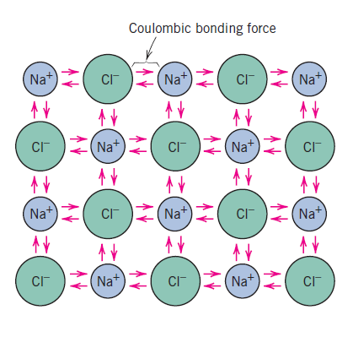
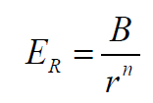
Primary interatomic bonds
Ionic Bonding
Coulombic bonding force : The attractive bonding forces E_{A}
Ԑ₀=the permittivity of a vacuum (8.85x10⁻¹² F/m), Z₁ and Z₂ = the valences of the two ion types,
e = the electronic charge (1.602x10⁻¹⁹ C).
Negative energy means attraction only.
Will the atoms collapse on themselves?
No, there is also repulsive energy (e.g. e-e repulsion)
B and n depend on atoms involved.
In many cases n ~ 8.

Slide 27
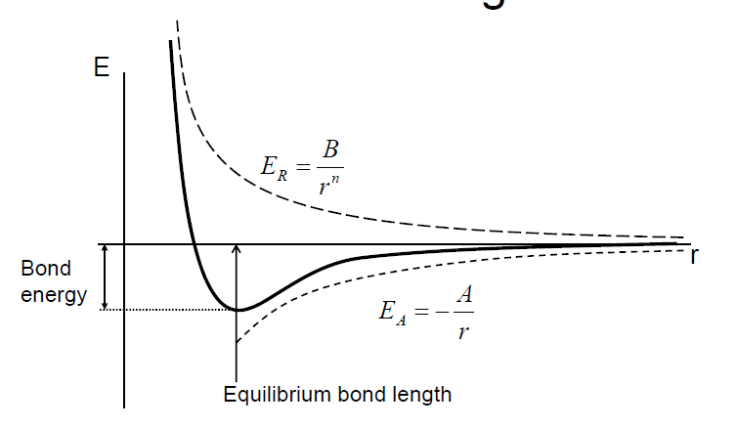
Primary interatomic bonds
Ionic Bonding
Note: Other types of bonds can also be described in a similar manner

Slide 28
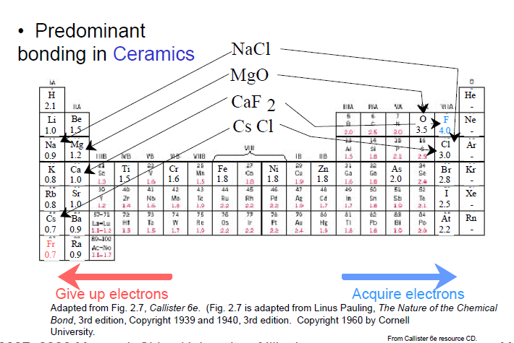
Primary interatomic bonds
Ionic Bonding
Ionic materials are characteristically hard and brittle and, furthermore, electrically and thermally insulative.

Slide 29
Primary interatomic bonds
Covalent Bonding
“Sharing” of electrons
Two atoms that are covalently bonded will each contribute at least one electron to the bond, and the shared electrons may be considered to belong to both atoms.
Schematic representation of covalent bonding in a molecule of methane (CH₄).
Example: CH₄
C: has 4 valence e, needs 4 more
H: has 1 valence e, needs 1 more
Electronegativities are same or comparable.

Slide 30
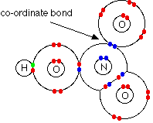
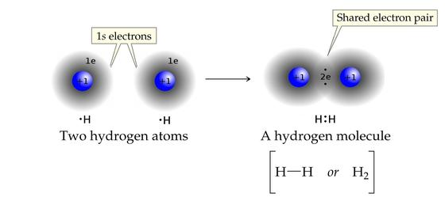
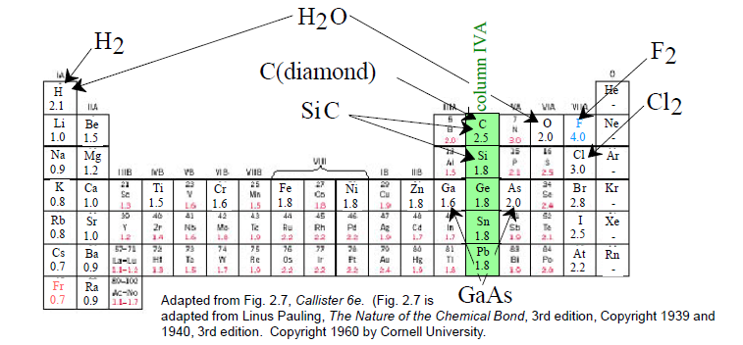
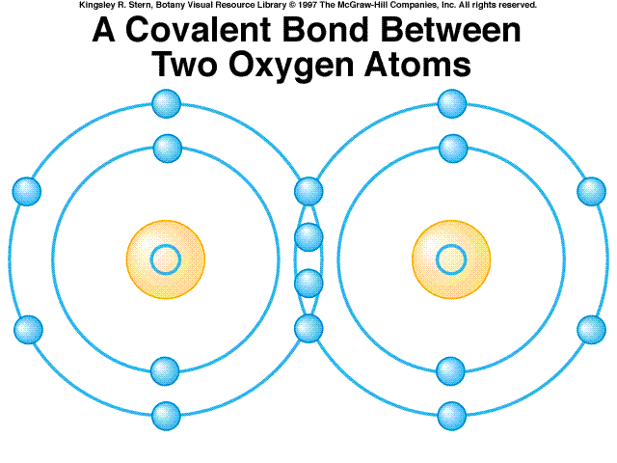

Primary interatomic bonds
Covalent Bonding
HNO₃
• Molecules with nonmetals
• Molecules with metals and nonmetals
• Compound solids (about column IVA)
H₂O

Slide 31

Primary interatomic bonds
% ionic character Covalent or ionic ???
Most bonds between two different types of atoms are somewhere in between ionic and covalent.
For a compound, the degree of either bond type depends on the relative positions of the constituent atoms in the periodic table, or the difference in their electronegativities
The percent ionic character (%IC) of a bond between elements A and B (A being the most electronegative) may be approximated by the expression
X_{A} and X_{B} are the electronegativities for the respective elements
the closer the atoms are together (i.e., the smaller the difference in electronegativity), the greater the degree of covalency
All properties of materials are largely determined by the types and strength of bonds between the constituent atoms.

Slide 32
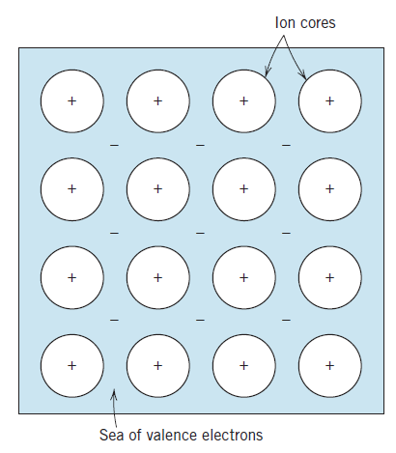
Primary interatomic bonds
Metallic Bonding
To be found in metals and their alloys.
metallic materials have maximum 3 valence electrons.
in this model, valence electrons are free and they move throughout the structure.
metals are good conductors of both electricity and heat, because of their free e⁻s.
ionically and covalently bonded materials are typically electrical and thermal insulators because of the absence of large numbers of free e⁻s.
Metallic bonds can be weak or strong.
Schematic illustration of metallic bonding.

Slide 33
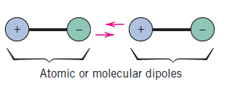
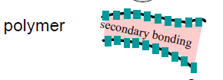
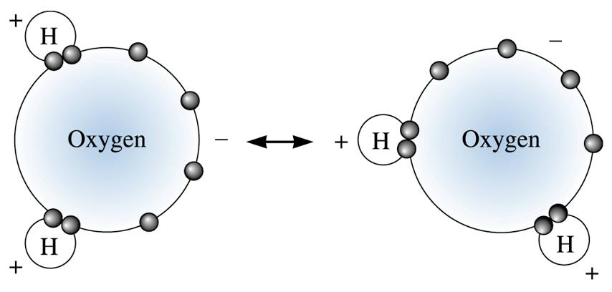
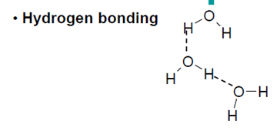
SECONDARY BONDING OR VAN DER WAALS BONDING
Secondary, van der Waals, or physical bonds are weak in comparison to the primary or chemical ones; bonding energies are typically on the order of only 10 kJ/mol.
Secondary bonding exists between virtually all atoms or molecules, but its presence may be obscured if any of the three primary bonding types is present.
Secondary bonding forces arise from atomic or molecular dipoles
Schematic illustration of van der Waals bonding between two dipoles.
Interactions are formed as a result of polarization of molecules or groups of atoms.

Slide 34

Secondary bonds in nature
fingers
micro-hair
nano-hair

Slide 35
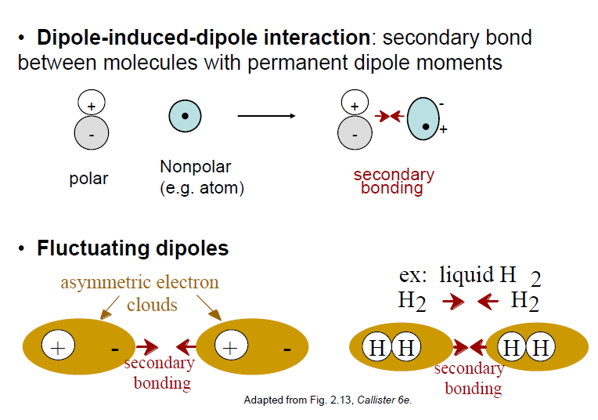
SECONDARY BONDING OR VAN DER WAALS BONDING
Non-symmetric
distribution of
+ and - regions
Permanent degradation
of electrical symmetry
If the amount of dipole bonds is high, melting and boiling points are extremely low.

Slide 36
Problem: Chromium has four naturally-occurring isotopes: 4.34% of ⁵⁰Cr with an atomic weight of 49.9460 amu, 83.79% of ⁵²Cr with an atomic weight of 51.9405 amu, 9.50% of ⁵³Cr with an atomic weight of 52.9407 amu, and 2.37% of ⁵⁴Cr with an atomic weight of 53.9389 amu. On the basis of these data, confirm that the average atomic weight of Cr is 51.9963 amu.
The average atomic weight of chromium is computed by adding fraction-of-occurrence/atomic weight products for the three isotopes. Thus (A Cr)
A Cr = f_{50Cr}A_{50Cr} + f_{52Cr}A_{52Cr}+ f_{53Cr}A_{53Cr}+ f_{54Cr}A_{54Cr}
= (0.0434)(49.9460 amu) + (0.8379)(51.9405 amu) +
(0.0950)(52.9407 amu) + (0.0237)(53.9389 amu)
= 51.9963 amu

Slide 37
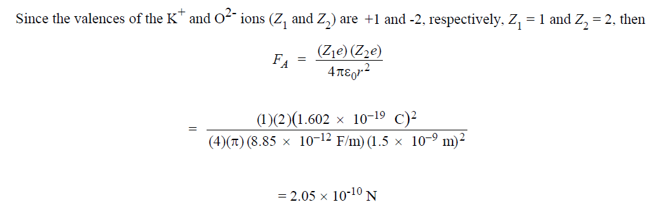
Problem: Calculate the force of attraction between a K⁺ and an O²⁻ ion the centers of which are separated by a distance of 1.5 nm.

Slide 38
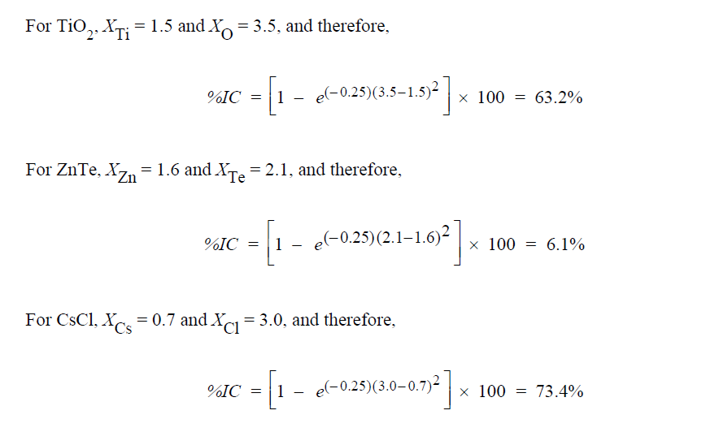


Problem: Compute the percents ionic character of the interatomic bonds for the following compounds: TiO₂, ZnTe, CsCl, InSb, and MgCl₂.

Slide 39

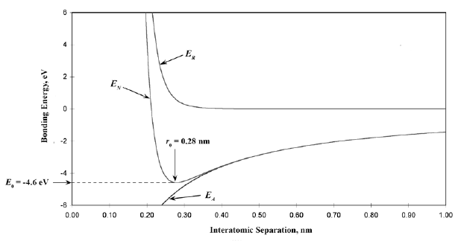
Problem: For a K⁺–Cl– ion pair, attractive and repulsive energies E_{A} and E_{R}, respectively, depend on the distance between the ions r, according to
For these expressions, energies are expressed in electron volts per K⁺–Cl– pair, and r is the distance in nanometers. The net energy E_{N} is just the sum of the two expressions above.
(a) Superimpose on a single plot E_{N}, E_{R}, and E_{A} versus r up to 1.0 nm.
(b) Determine the equilibrium spacing r₀ between the K⁺ and Cl– ions, and the magnitude of the bonding energy E₀ between the two ions.

